Slide 1
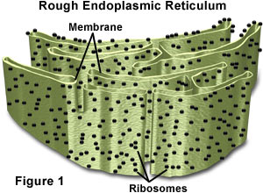
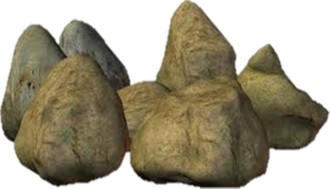
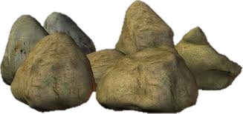
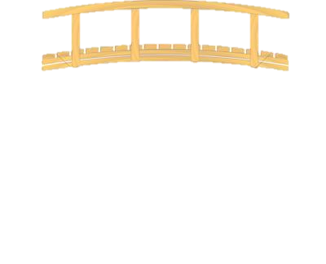
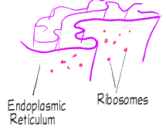
In hole #1 I decided to put the E.R. and Ribosomes together because they both work with proteins
The Endoplasmic Reticulum's function is to work as the packaging system for the cell.
Boulder Ridge
7
Start
Ribosomes can be found floating free in the cytoplasm or attached to the E.R. Ribosomes are the protein makers for the cell.
Hole #7

Slide 2
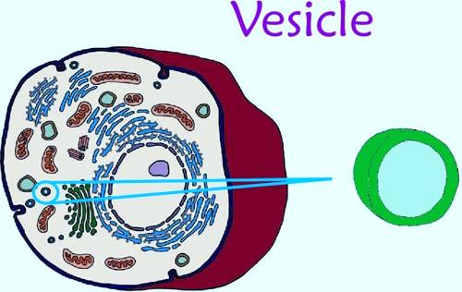
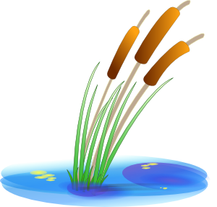
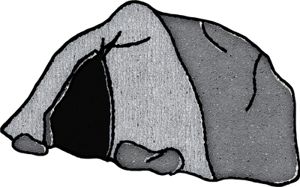
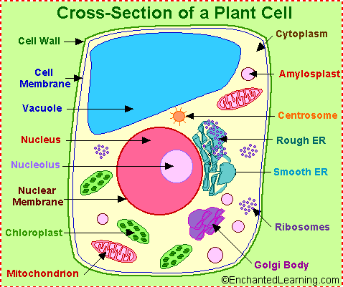
Vesicles are small organelles that move materials in and out of the cell. Their function is to store materials such as, food and sugars.
Hole #8
8
I chose to put these two organelles together because the work with the transportation and storing of materials in the cell.
Rush lake
A Vacuole is a large organelle. The size of the vacuole allows It to hold more water, so it is able to replenish plants when it does not rain.
Start

