Slide 1
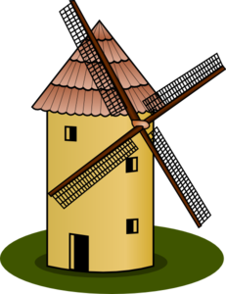
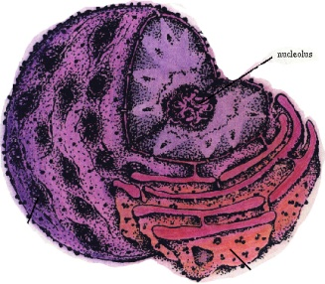
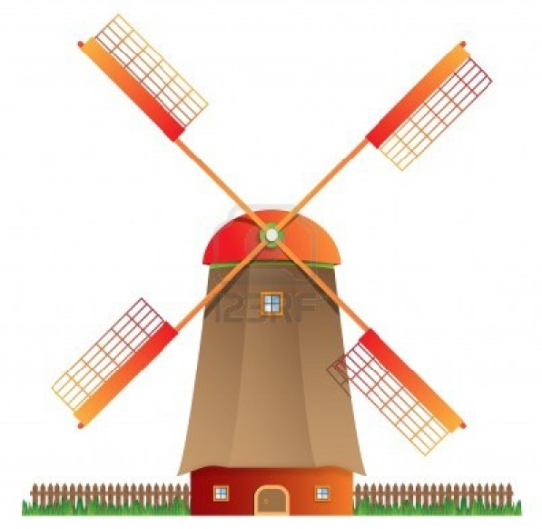
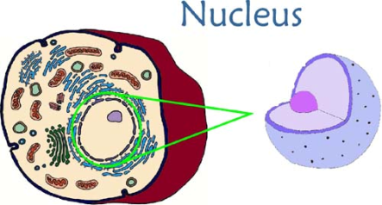
The opening of the cave represents the nucleus and the hole represents the nucleolus. I choose to do it like this because the nucleolus is found inside the nucleus. The nucleolus's main function in a cell is to produce ribosomes.
#4
Power Hole
The nucleus is like the power house of the cell and that’s where all the information is stored. This is why I choose to represent it as a windmill.
Start
I put these two organelles together because the nucleolus if found inside the nucleus.

Slide 2
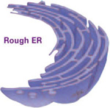
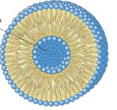
Hole #5
Emergencia
I put these two structures together because a protein is made inside the ER and is carried away by a vesicle
In my course the golf ball will represent the ribosome. It will have to travel through the series of winding back and fourth witch represents the endoplasmic reticulum.
Once the golf ball is out of the winding it them becomes a vesicle with a protein inside of it. I represented it like this because once a protein is made inside of the ER it is then taken away inside a vesicle.
Start

