Slide 1
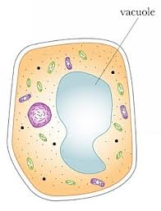
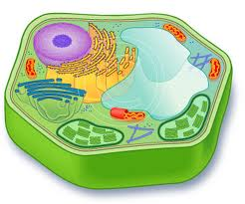
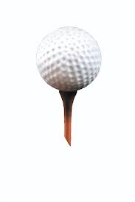
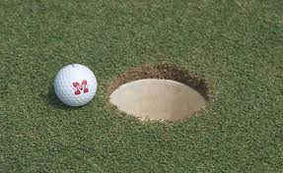
Hole 1 “Water Walls”
Cell Wall
The cell wall protects, supports, and gives the cell shape.
The vacuole stores the fluids inside the cell.
The vacuole containing fluid pushes through the cell wall to release the fluids out of the cells.

Slide 2
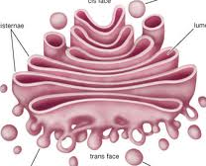
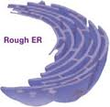
“The Rough Winder” Hole2
On a slight hill so ball can roll down through the tube.
Golgi apparatus
Process, sorts, and delivers proteins.
Produces, processes, and distributes proteins.
The E.R. manufactures membranes that surround vesicles that make up the Golgi apparatus.

